Slide 1
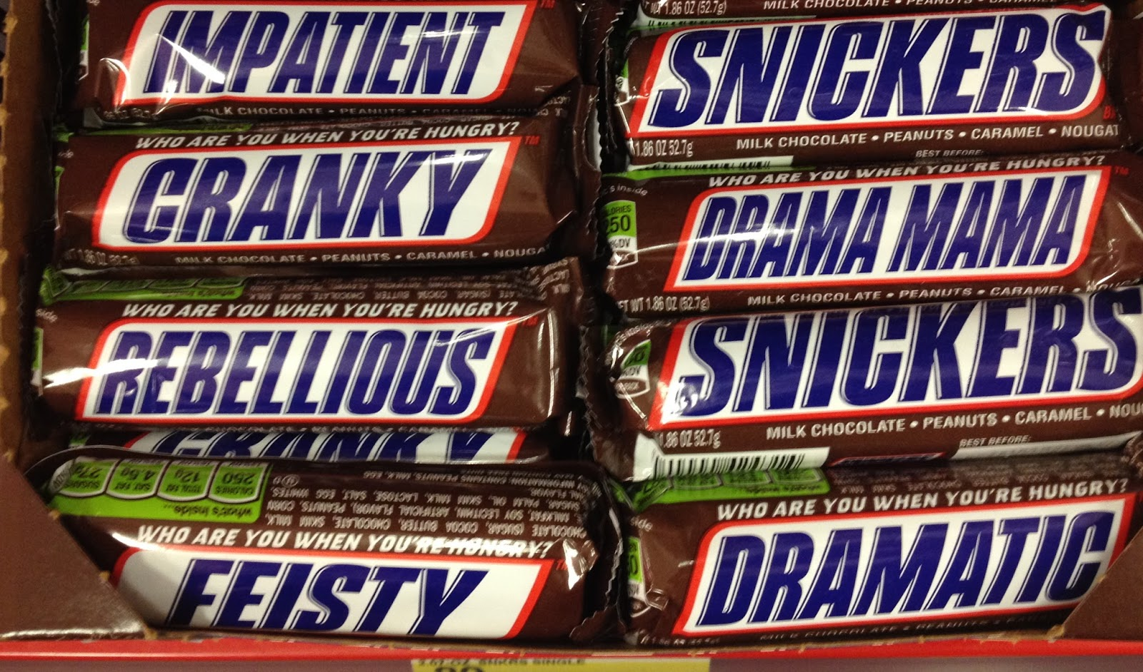
SNICKR
Semantic Network For Clinical Knowledge Representation
Jay B. Krasner, MD, FACP

Slide 2
Prologue
Current health information exists primarily for the benefit of administrators, third party payors, software vendors, their underlings, henchpeople and cronies

Slide 3
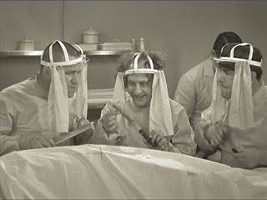
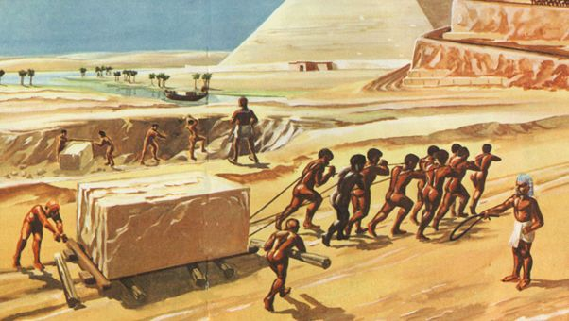
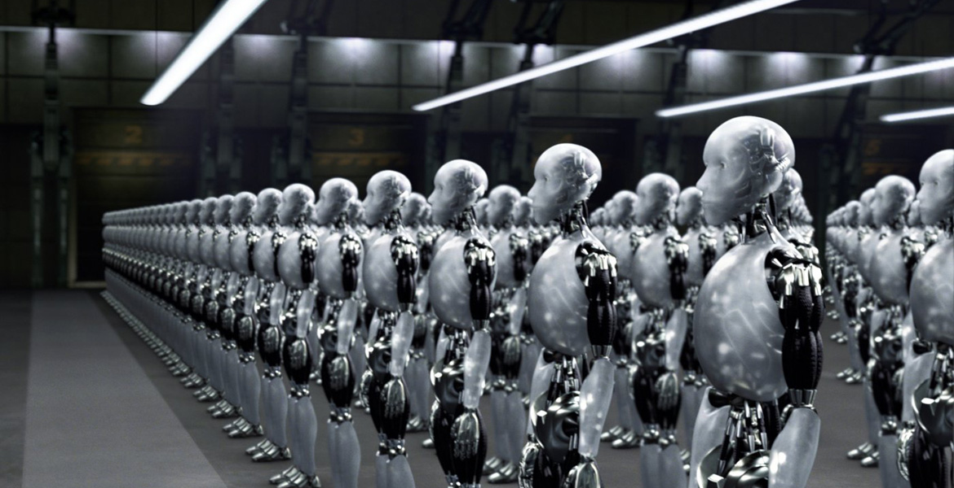
Prologue
Current health information exists primarily for the benefit of administrators, third party payors, software vendors, their underlings, henchpeople and cronies
IMHO, How they regard actual health providers:

Slide 4
Prologue
Current health information exists primarily for the benefit of administrators, third party payors, software vendors, their underlings, henchpeople and cronies
so …

Slide 5
Introduction
Clinical information vs. clinical knowledge
Clinical Information:
Patient-specific clinical data
Clinical knowledge:
External information used by providers
to process clinical information for management
of a distinctive situation
Sources of clinical knowledge: textbooks,
journals, mnemonics, web pages, etc.

Slide 6
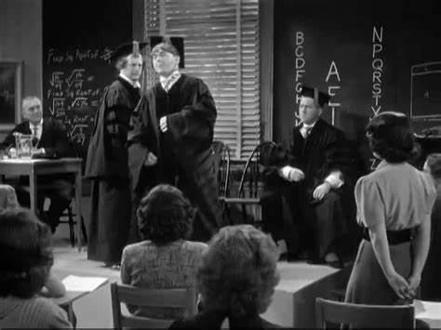
English grammar review

Slide 7
English grammar review
4 types of English sentences
Interrogatory:
“Do you feel lucky, punk? Well, do ya?”
Imperative:
“Use the Force, Luke.”
Exclamatory:
“This! Is! Sparta!”
Declarative

Slide 8
English grammar review
Types of English declarative sentences
predicate
Subject + [verb + adjunct(s)]
Example
Subject + intransitive verb + Ø
I am sleeping.
Subject + linking verb + adjectival complement
This presentation seems boring and pointless.
Subject + linking verb + subject complement
I am the Walrus. (goo-goo-ga-joob)
Subject + transitive verb + direct object
She loves you. (yeah-yeah-yeah)
She showed me her room.
(isn’t it good Norwegian Wood)
Subject + ditransitive verb + indirect object + direct object
Subject + complex-transitive verb + direct object + object complement
You make me dizzy. (Miss Lizzy)

Slide 9
English Grammar Review
The simplest Subjects and Adjuncts are:
Single nouns

Slide 10
Premise #1:
Most nonquantitative clinical Knowledge can be represented in a data structure analogous to an declarative sentence

Slide 11
Premise #1:
Most nonquantitative clinical Knowledge can be represented in a data structure analogous to a declarative sentence
How?

Slide 12
Clinical Statement
The Fundamental Unit of SNICKR
Declarative sentence ⇒ Clinical statement
Subject (single noun) ⇒ Clinical entity
Verb ⇒ Semantic Relation
Adjunct ⇒ Dataset
Clinical statement = Clinical entity + Semantic Relation + Dataset
There is a 1:1 relationship between {Clinical Entity, Semantic Relation}
and Dataset

Slide 13
Declarative sentence ⇒ Clinical statement
Subject (single noun) ⇒ Clinical entity
Verb ⇒ Semantic Relation
Adjunct ⇒ Dataset
Clinical statement = Clinical entity + Semantic Relation + Dataset
There is a 1:1 relationship between {Clinical Entity, Semantic Relation}
and Dataset

Slide 14
Clinical Entity
An unambiguous term describing a clinical concept, e.g,,
Anatomic structure
Physiologic process
Biochemical reaction
Disease
Symptom
Sign
Organism
Diagnostic intervention
Therapeutic intervention
etc.
Clinical statement = Clinical entity + Semantic Relation + Dataset

Slide 15
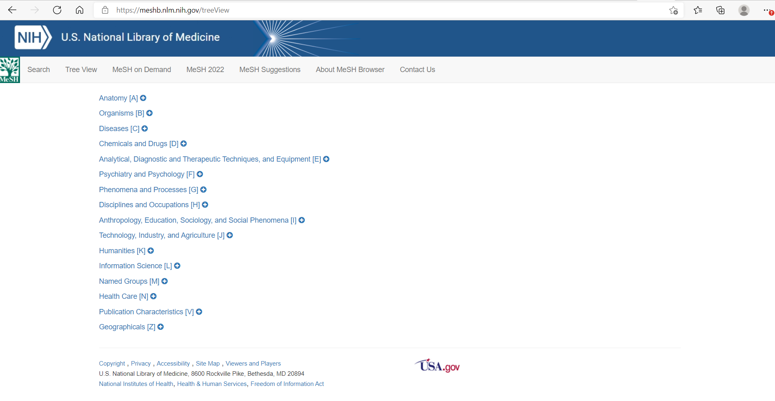
Clinical Entity
Already been done (the MeSH tree)

Slide 16
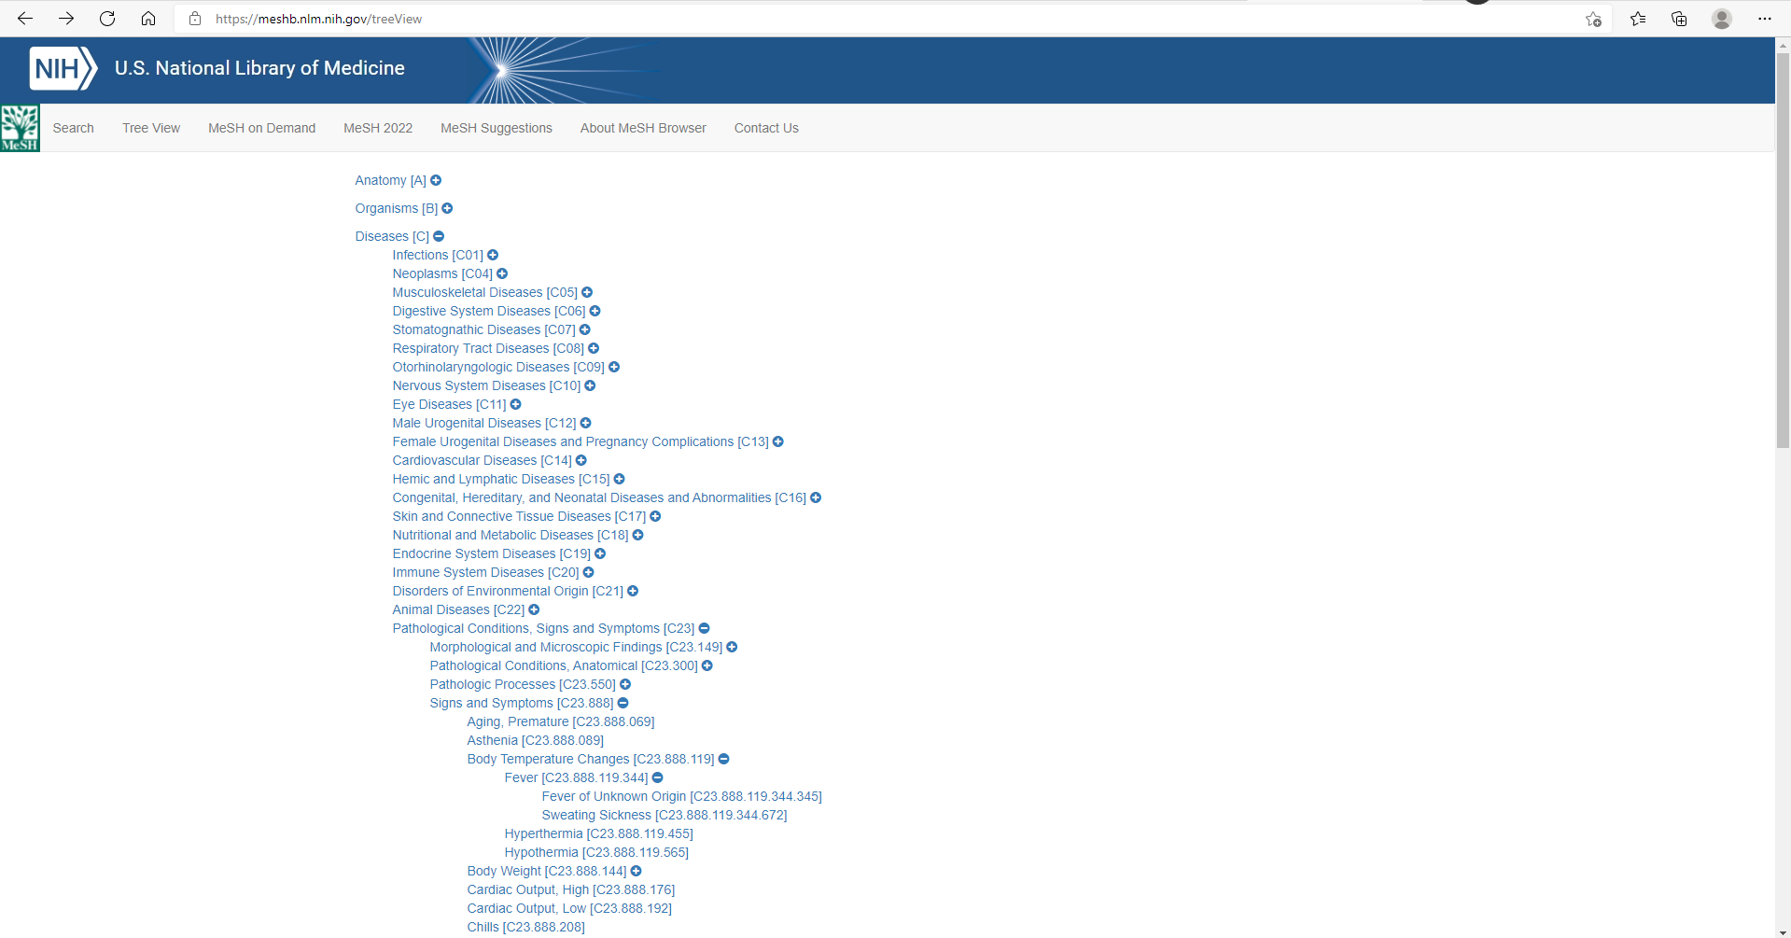
Clinical Entity
Already been done (the MeSH tree)
Clinical Entities

Slide 17
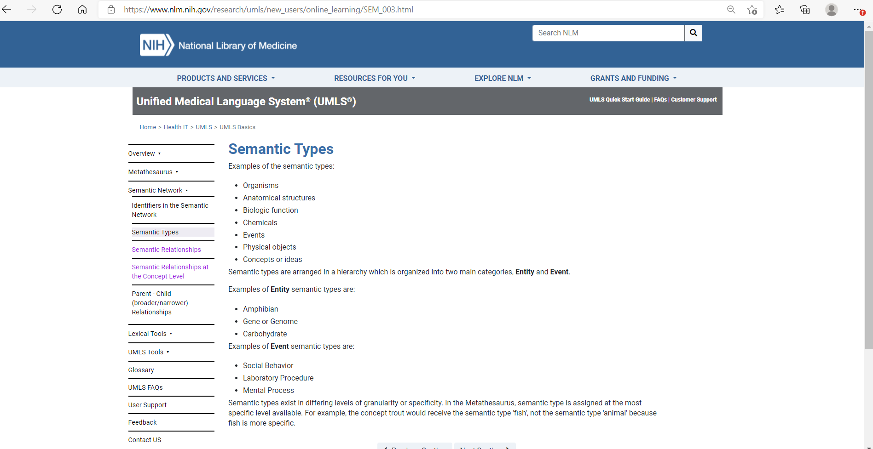
Clinical Entity
Already been done (UMLS Semantic Types)

Slide 18
Clinical Entity
Already been done (UMLS Semantic Types)
aapp|T116|Amino Acid, Peptide, or Protein
acab|T020|Acquired Abnormality
acty|T052|Activity
aggp|T100|Age Group
amas|T087|Amino Acid Sequence
amph|T011|Amphibian
anab|T190|Anatomical Abnormality
anim|T008|Animal
anst|T017|Anatomical Structure
antb|T195|Antibiotic
arch|T194|Archaeon
bacs|T123|Biologically Active Substance
bact|T007|Bacterium
bdsu|T031|Body Substance
bdsy|T022|Body System
bhvr|T053|Behavior
biof|T038|Biologic Function
bird|T012|Bird
…

Slide 19
Premise #1:
Most nonquantitative clinical Knowledge can be represented in a data structure analogous to a declarative sentence
Premise #2:
There are between 10³ and 10⁴ Clinical Entities relevant to clinical medicine. Existing vocabularies can be used.

Slide 20
Dataset
A collection of one or more Clinical Entities grouped in one of several defined structures:
Single clinical entity
Simple List
Nested List, aka outline, tree
Table
Clinical statement = Clinical entity + Semantic Relation + Dataset

Slide 21
Dataset Single clinical entity
Syphilis is caused by Treponema pallidum
Treponema pallidum causes syphilis
Syphilis is a bacterial infection
Bacterial infection includes syphilis

Slide 22
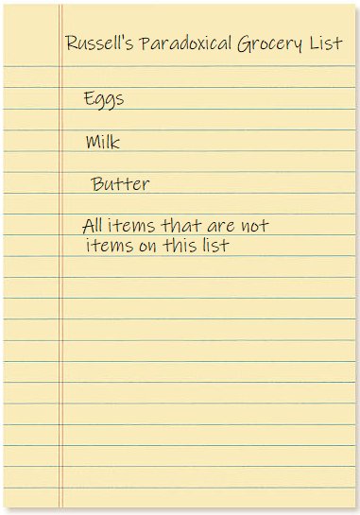
Dataset Simple list
Millenial grocery list has the items
Kale
Sriracha
Kombucha
Quinoa
Matcha
Fake meat
Avocado
Gluten-free anything
Salted caramel anything
Stuff that boomers like

Slide 23
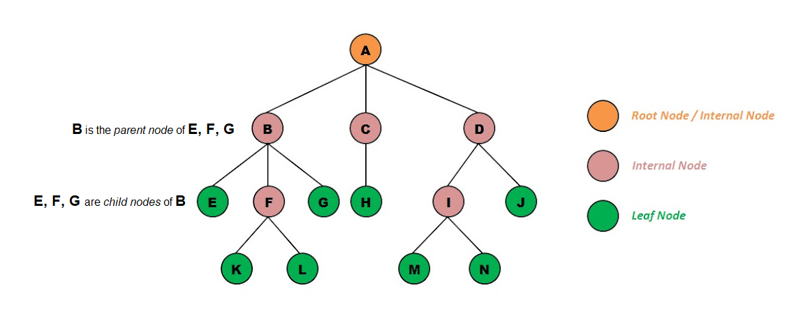
Dataset Nested List
A hierarchical list of arbitrary depth, like an outline. Also known as a tree data structure. In NerdSpeak, an acyclic directed graph with a specified root node and unique pathways from root node to every leaf node

Slide 24
Dataset Nested List
When you turn a tree on its side -
-from MeSH:
Ocular Motility Disorders [C11.590]
Duane Retraction Syndrome [C11.590.224]
Miller Fisher Syndrome [C11.590.312]
Nystagmus, Pathologic [C11.590.400]
Nystagmus, Congenital [C11.590.400.300]
Oculomotor Nerve Diseases [C11.590.436]
Adie Syndrome [C11.590.436.200]
Oculomotor Nerve Injuries [C11.590.436.600]
Ophthalmoplegia [C11.590.472]
Ophthalmoplegia, Chronic Progressive External [C11.590.472.250]
Kearns-Sayre Syndrome [C11.590.472.250.500]
Ophthalmoplegic Migraine [C11.590.472.375]
Supranuclear Palsy, Progressive [C11.590.472.500]
Opsoclonus-Myoclonus Syndrome [C11.590.725]
Strabismus [C11.590.810]
Esotropia [C11.590.810.400]
Exotropia [C11.590.810.440]
Tolosa-Hunt Syndrome [C11.590.905]

Slide 25
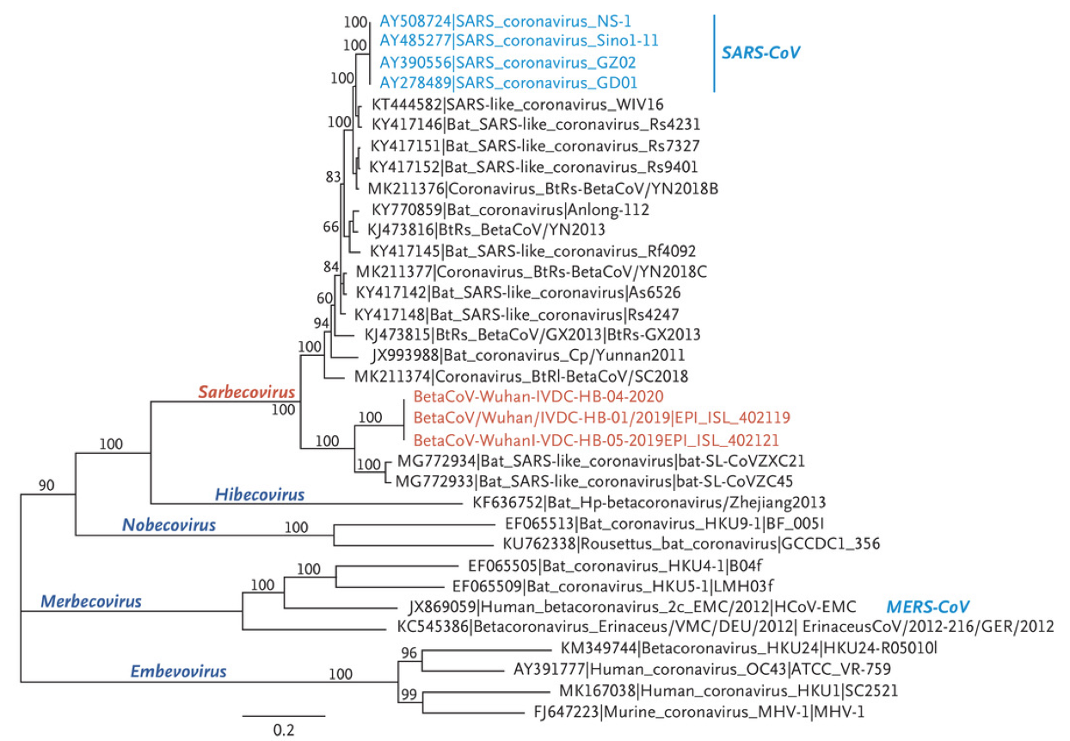
Dataset Nested List

Slide 26
Dataset Table
A table is a 2-dimensional structure of information.
The row and column headers for the table are Clinical Entities.
The cells at the intersection can contain:
Linked information
A single Clinical Entity
Unlinked information
Quantitative information (number)
Semiquantitative (e.g. 0+ to 4+ scale)
Boolean (true/false) information
Free (unstructured) text

Slide 27
Dataset
limitations
Data that cannot be easily represented by a dataset:
Algorithms, flow charts, etc. where
A child node can have more than one parent node, or
The graph has a cycle (a closed loop between nodes)
Equations
Graphic structures to display quantitative information

Slide 28
Semantic Relation
The term describing the relation between a Clinical Entity and a Dataset
Clinical statement = Clinical entity + Semantic Relation + Dataset

Slide 29
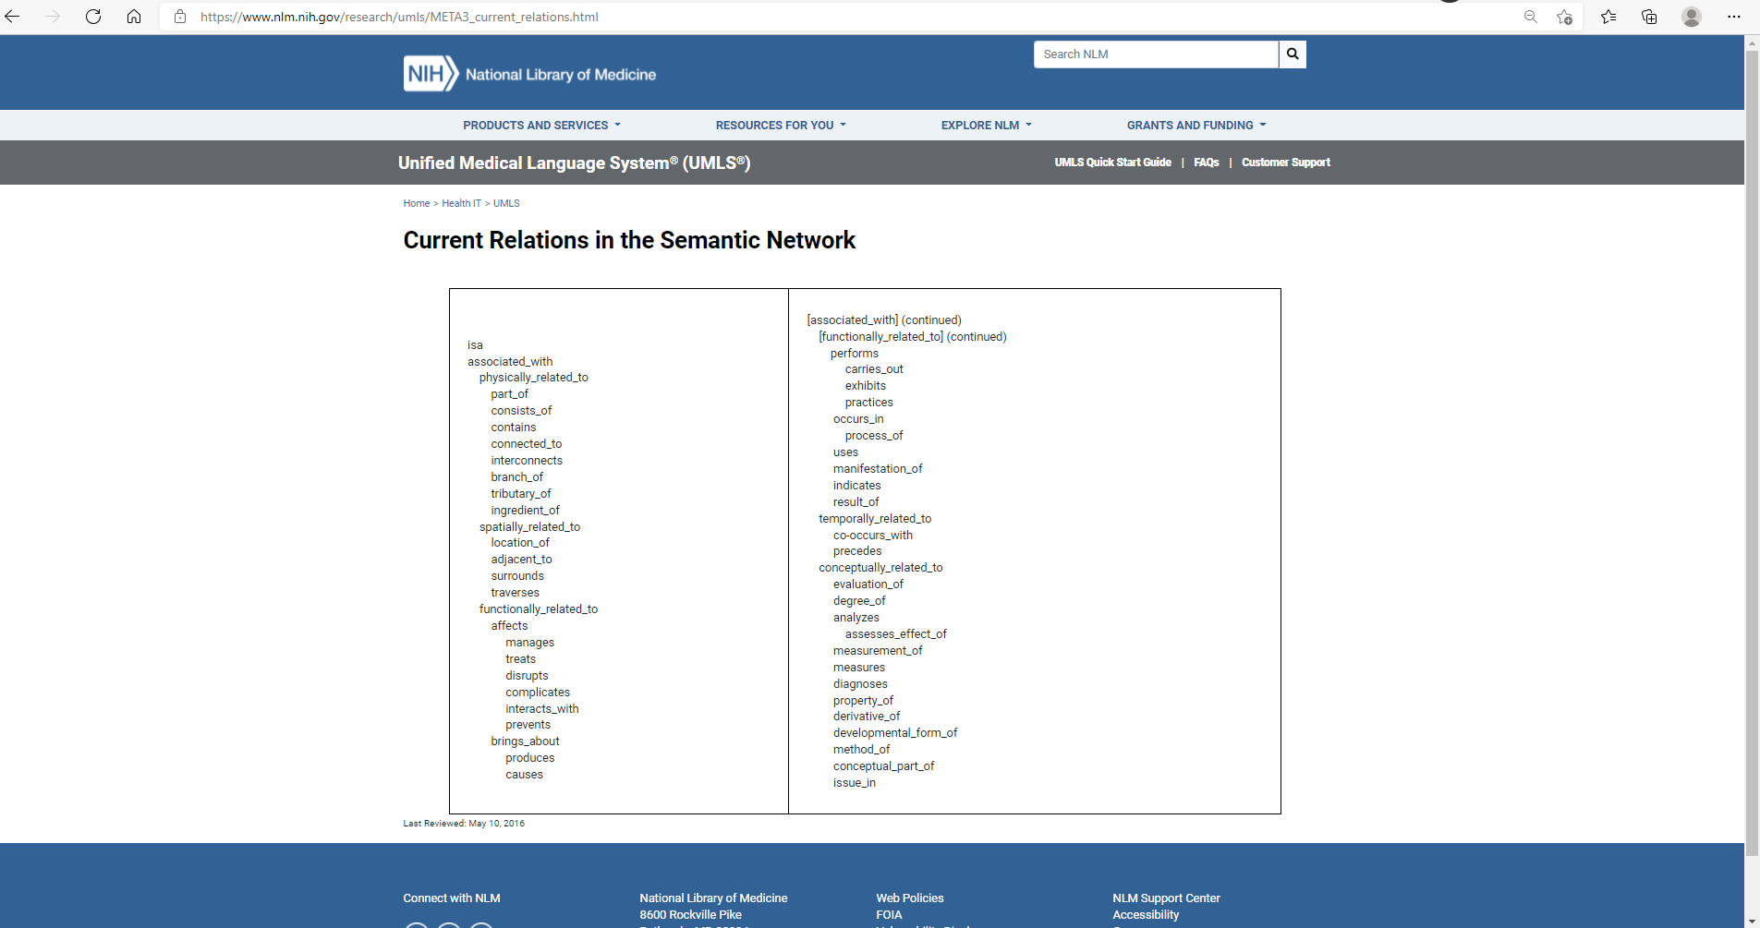
Semantic Relation
The term describing the relation between a Clinical Entity and a Dataset
Already been done, too. From UMLS:

Slide 30
Semantic Relation
The UMLS Semantic Network Relationships schema is overly broad
with respect to clinical medicine
The UMLS Semantic Network Relationships schema is not granular enough
with regard to clinical relationships
The UMLS Semantic Network Relationships schema is not bidirectional
We want:
Is A Type Of ⬄ Includes
Causes ⬄ Is Caused By
A Semantic Relation vocabulary for clinical medicine is easy to build

Slide 31
Premise #1:
Most nonquantitative clinical Knowledge can be represented in a data structure analogous to a declarative sentence
There are between 10³ and 10⁴ Clinical Entities relevant to clinical medicine. Existing vocabularies can be used.
Premise #2:
There are ~10² Semantic Relations relevant to clinical medicine. A vocabulary is easy to create.
Premise #3:
Most nonquantitative clinical Knowledge can be represented by ≤10⁶ Clinical Statements
Conclusion:

Slide 32
WHY BOTHER WITH ALL OF THIS?

Slide 33
WHY BOTHER WITH ALL OF THIS?
Allow for navigation around the entire system quickly and intuitively

Slide 34
ProtoType Specifications
Each Clinical Entity has its own .html digital file (~10⁴ files)
All the Clinical Statements for that Clinical Entity are in that file
There is a standard data format (Javascript Object) for each type of Dataset
There is a template to allow nonprogrammers to create Datasets
There is a standalone API (Application Programming Interface) to render the digital files
(no software on the page), also in Javascript
MeSH vocabulary will be used for Clinical Entities
Semantic Relations will use the UMLS vocabulary as a framework, but will be
expanded, with bidirectionality
Each Table and Nested List will be derived from a single external data source;
Simple Lists will be compiled from multiple (mostly internal) data sources.
* The Clinical Entity files could be .xml and the API could be XSLT (fielder’s choice) *

Slide 35
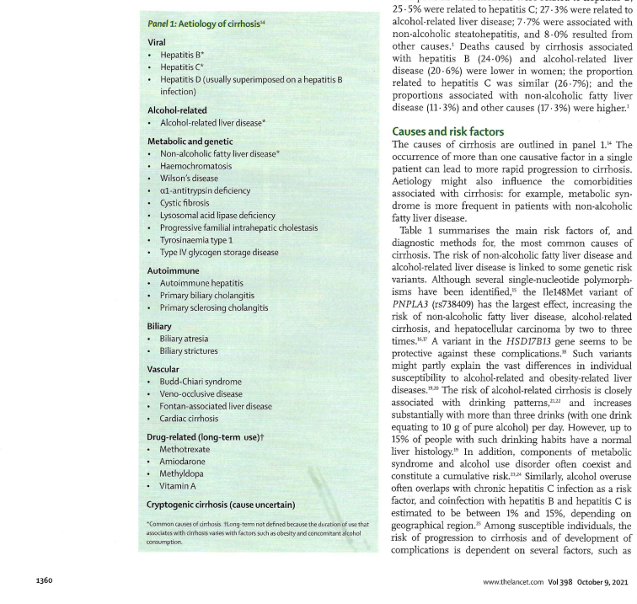
Typical source document

Slide 36
Semantic relation and Dataset as Javascript Object
srcObj['_is_caused_by'] = {
reference : {
refText : 'Gines P, Krag A, Abraides J et al. Liver Cirrhosis. Lancet 2021: 398(1359-76)',
refLink : 'https:doi.org/10.1016/S0140-6736(21)01374-X',
},
datasetType : 'nestedList',
dataset : {
'Viral hepatitis' : {'link' : 'D006525',
'Hepatitis B' : {'link' : 'D006509'},
'Hepatitis C' : {'link' : 'D006526'},
'Hepatitis D' : {'link' : 'D003609'},
},
'Liver Cirrhosis, Alcoholic' : {'link' : 'D008104'
},
'Metabolic and genetic' : {'link' : 'nolink',
'Non-alcoholic Fatty Liver Disease' : {'link' : 'D065626'},
'Hemochromatosis' : {'link' : 'D006432'},
'Wilson\'s Disease' : {'link' : 'D006527'},
'Alpha-1 antitrypsin deficiency' : {'link' : 'D019896'},
'Cystic fibrosis' : {'link' : 'D003550'},
'Lysosomal acid lipase deficiency' : {'link' : 'D015217'},
'Progressive familial intrahepatic cholestasis' : {'link' : 'D002780'},
'Tyrosinemia type I' : {'link' : 'D020176'},
'Glycogen storage disease type IV' : {'link' : 'D006011'},
},
'Autoimmune' : {'link' : 'D001327',
'Autoimmune hepatitis' : {'link' : 'D019693'},
'Primary biliary cirrhosis' : {'link' : 'D008105'},
'Primary sclerosing cholangitis' : {'link' : 'D015209'},
},
'Biliary' : {'link' : 'D001660',
'Biliary atresia' : {'link' : 'D001656'},
'Biliary stricture' : {'link' : 'nolink'},
},
'Vascular' : { 'link' : 'nolink',
'Budd-Chiari syndrome' : { 'link' : 'D006502'},
'Veno-occlusive disease' : { 'link' : 'D006504'},
'Fontan-associated liver disease' : { 'link' : 'D018729'},
'Cardiac cirrhosis' : { 'link' : 'nolink'},
},
'Drug-related' : {'link' : '#',
'Methotrexate' : { 'link' : 'D008727'},
'Amiodarone' : { 'link' : 'D000638'},
'Vitamin A' : { 'link' : 'D0014801'},
},
},
};

Slide 37
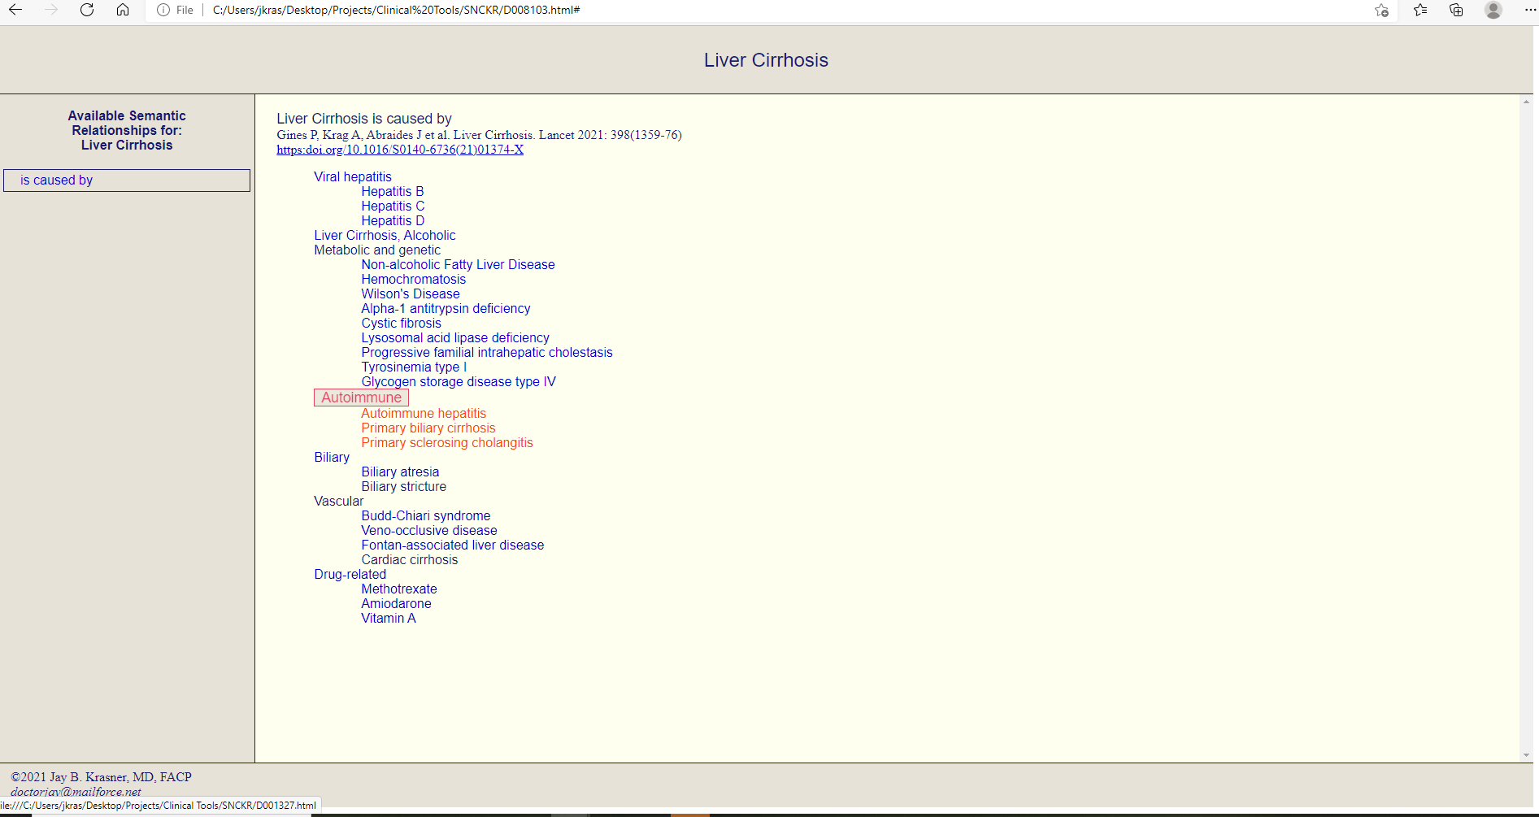
What it looks like in person

Slide 38
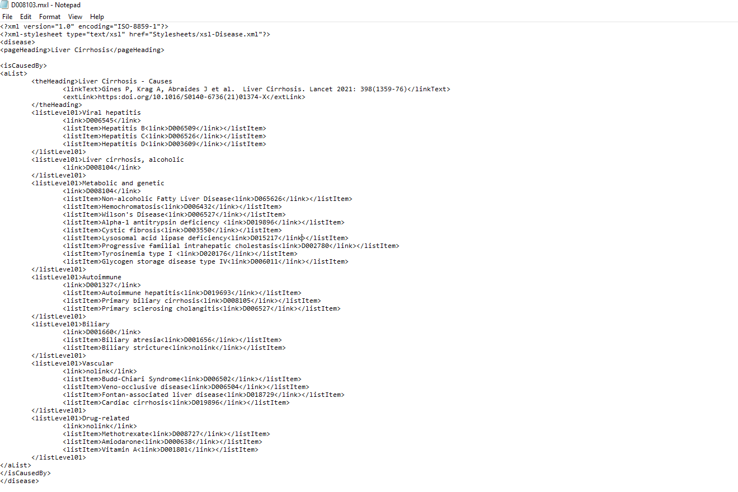
Portion of Clinical Entity document in XML

Slide 39
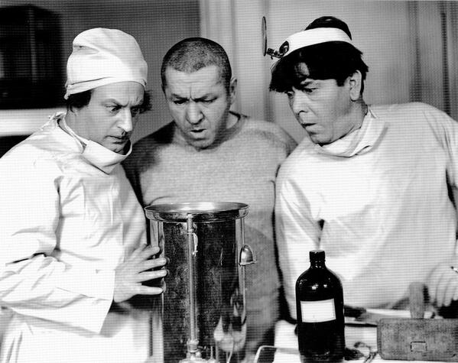
Can it work?

Slide 40
Can it work?
.html files are text files with UTF-8 encoding (nearly always 1 byte per character)
A typical Clinical Entity file is between 10 and 100 kilobytes
Assuming 10⁴ files, space required for the entire network is 100kb x 10⁴ = 10⁹ bytes
10⁹ bytes = 1 GB

Slide 41
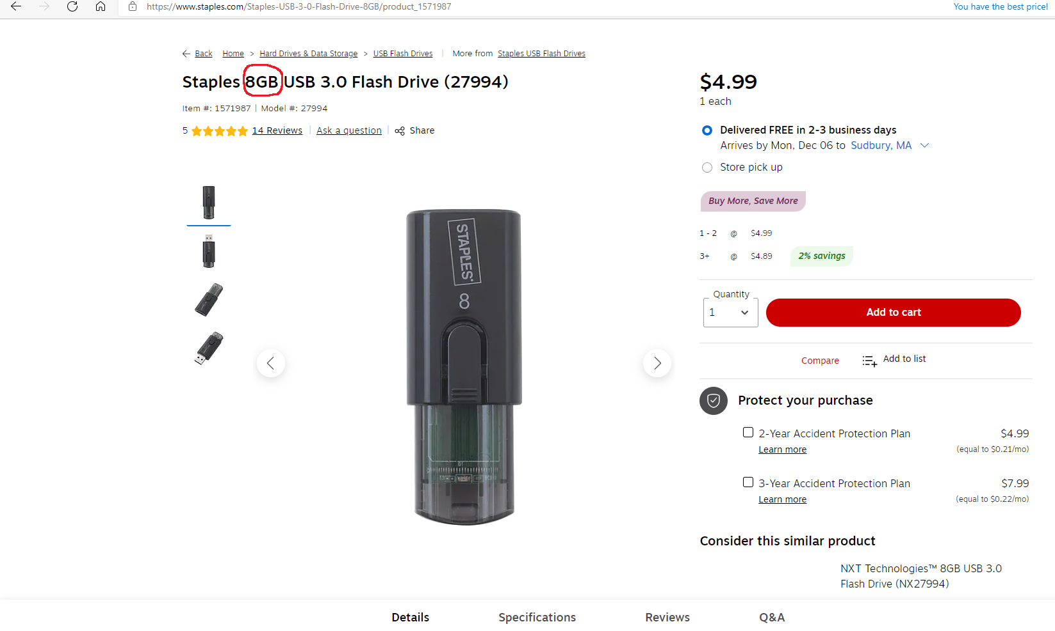
Can it work?
Yeah, I think so!
The limitation will be server traffic capacity, not data space

